Slide 1
SOLID (Object-oriented design)
Single responsibility principle
Open/closed principle
Liskov substitution principle
Interface segregation principle
Dependency inversion principle

Slide 2
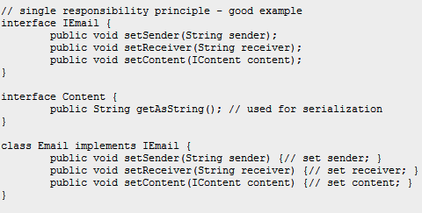
Single responsibility principle
Each class should be restricted to achieve a single task, or handle a single aspect of the application.
A simple change to the application design specification should only change the purpose of a single class
http://www.oodesign.com/single-responsibility-principle.html

Slide 3
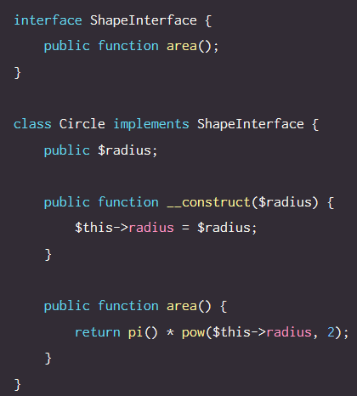
Open/closed principle
Objects and entities in software should be open for extension, but closed for modification from external entities.
Extension of an entity should be easily extendable, with no changes of the base class being required.
i.e. no special casing required
https://scotch.io/bar-talk/s-o-l-i-d-the-first-five-principles-of-object-oriented-design

